Slide 1
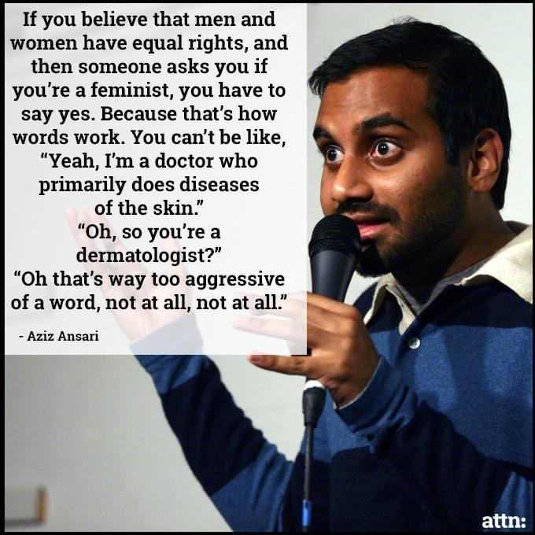
Twitter & Feminism
Pilot Study

Slide 2
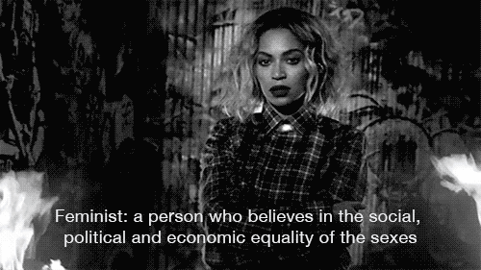
What is Feminism?

Slide 3
What is a pilot study?
A pilot study is an initial run-through of the procedures to be used in an investigation; it involves selecting a few people and trying out the study on them. It is possible to save time, and in some cases, money, by identifying any flaws in the procedures designed by the researcher.
A pilot study can help the researcher spot any ambiguities (i.e. unusual things) or confusion in the information given to participants or problems with the task devised.
Gist: Pilot Studies are a rough draft to prove that studying it “for real” would be worthwhile.
McLeod, S. A. (2007). Psychology Research Methods. Retrieved from http://www.simplypsychology.org/research-methods.html

Slide 4
Why Twitter?
Twitter is becoming a recognized and valid measure of the zeitgeist.
Twitter is being used to collect data by social scientists.
Using Twitter for Demographic and Social Science Research: Tools for Data Collection http://paa2013.princeton.edu/papers/130624

Slide 5
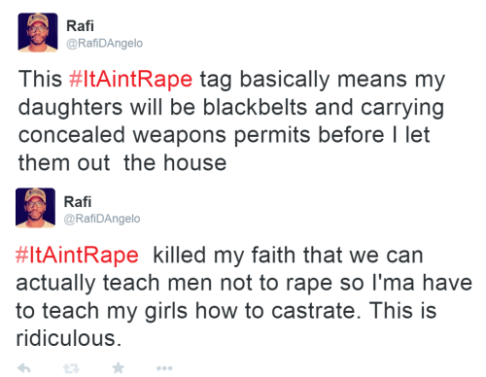
Continued
Viral marketing, memetic theory and the ability of small groups to control the space create new and more polarized dialogues.
Current debate on extremism — “The Counter Extremism Project welcomes press reports that Twitter Chief Executive Officer Dick Costolo has publicly acknowledged his platform’s failure to combat online abuse. This is clearly – even dangerously – overdue.” http://www.counterextremism.com/press/counter-extremism-project-calls-twitter-confront-all-abuse#sthash.bjDAXHzU.dpuf

Slide 6
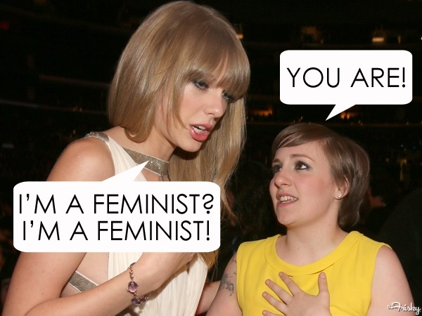
Why Feminism?
Renewed interest and dialogue on new media
Attention in traditional media, celebrities taking visible stances
2014 as a bumper year for pop feminism, contraceptives, legal abortion, etc.

Slide 7
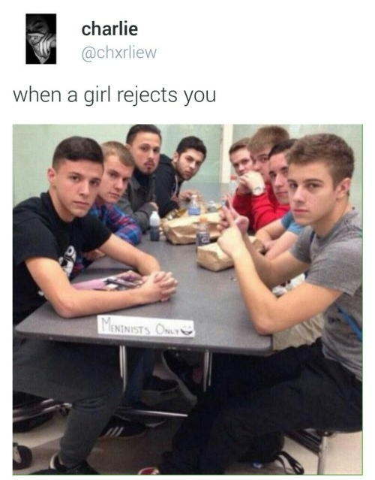
Continued
Potential backlash from last year
Hunger Games and Frozen to 50 Shades of Grey and Meninism
GamerGate is still a thing
MRAs
Caption: Meninist Only :D

Slide 8
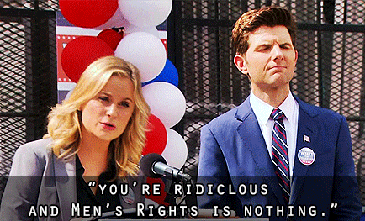
“Can we have ONE conversation about feminism where men get to be in charge?”

Slide 9
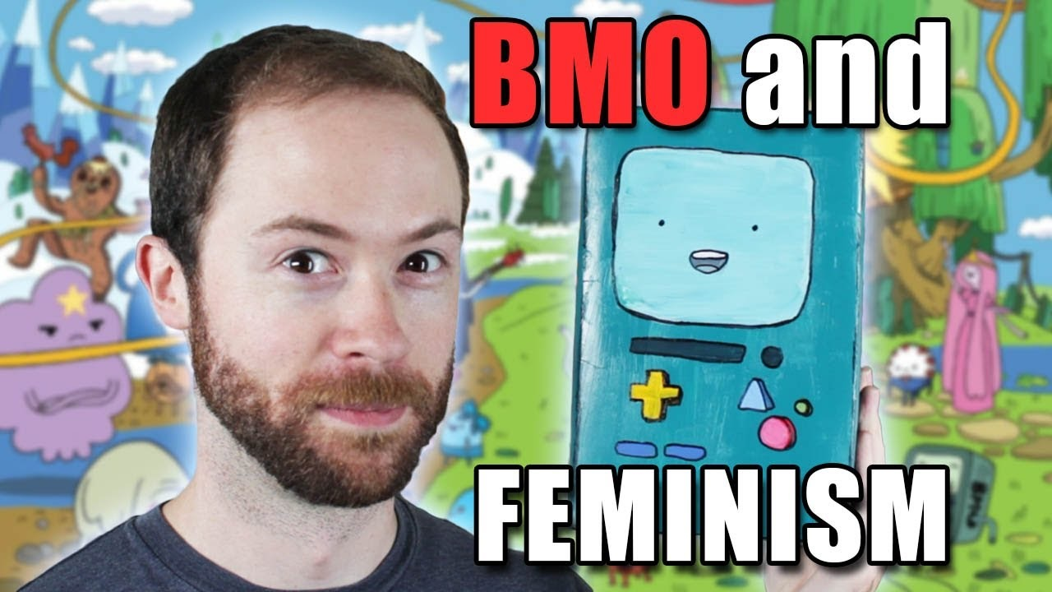
Current Feminism: A Refresher

Slide 10
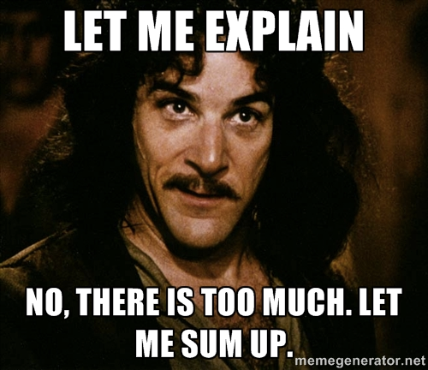
Feminism :
A Very Short History
First Wave: Women’s suffrage and basic political inequalities.
Second Wave: Mid-60s onward, social and cultural inequalities beyond basic political inequalities.
Third Wave: 90s and ongoing, focus on queer/trans/PoC and other diversity voices. Intersectionality, gender discrimination, and the normalization of BMO.

Slide 11
Feminism is having a fascinating moment and is noteworthily well documented via social media in a way that captures, more precisely and more accurately than before, the public opinion as it evolves on modern feminism.
For example, that was posted by the “Independent Women’s Forum”

Slide 12
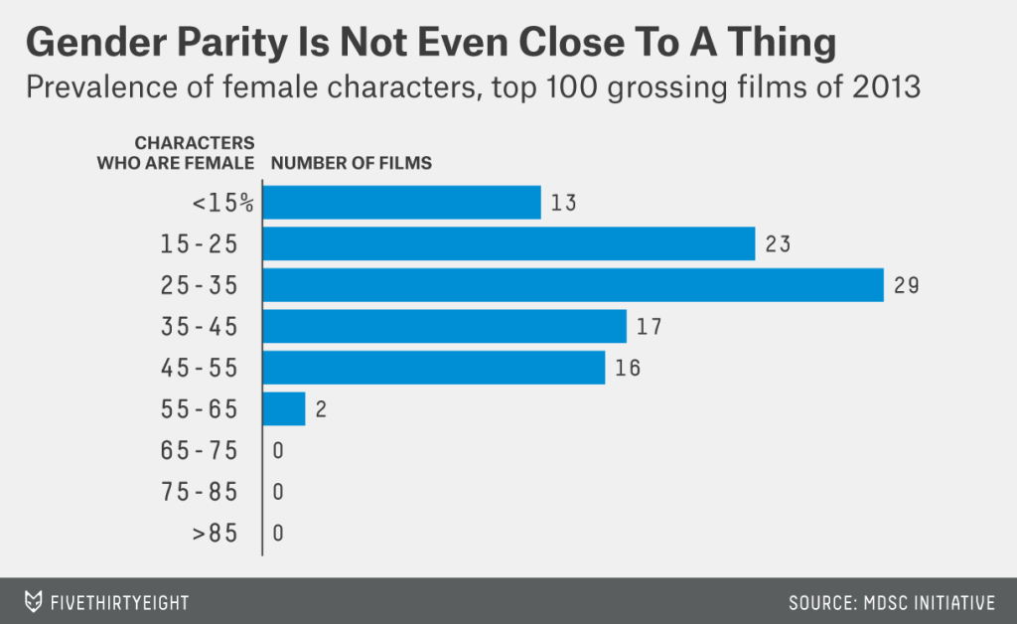
http://fivethirtyeight.com/features/how-to-measure-women-film-annenberg/

Slide 13
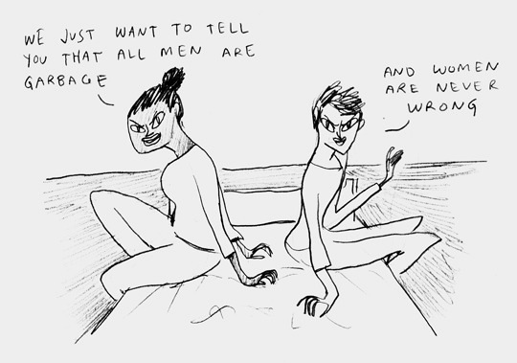
Straw Feminism

Slide 14
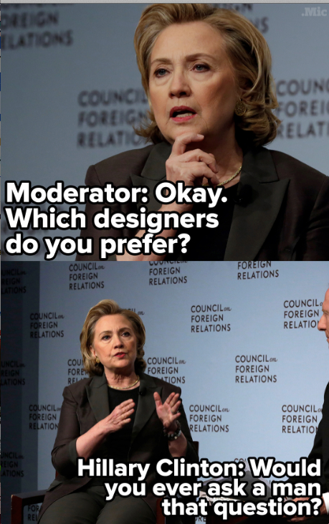
Method
I wrote a code that captures tweets from the Twitter LiveStream
People with public twitter feeds who tweeted, during the 7 random times of day I ran the code, with the word “feminist” or “feminism”, make up the “participants.”
I collected 30k tweets.

Slide 15
Method- Cont. : Procedure
Sub-section of random tweets hand-coded for valence (positive or negative leaning):
0 : positive or neutral opinions on feminism (discussions of feminism, even the problems with it, etc)
1: negative opinions of feminism or hate speech (denying feminism is real/needed/valid, hate speech against women, etc)
Coded tweets used to train various machine learning model, and then test them. Models then extrapolated onto the much larger corpus of tweets to measure them for perceived valence on feminism.

Slide 16
False Positive and Patton Oswalt
Pros: Some context and humor controlled for by human coding
Cons: Time consuming, low context, uncaught irony
http://www.huffingtonpost.com/2013/08/19/patton-oswalt-trolls-twitter-conservatives_n_3779803.html

Slide 17
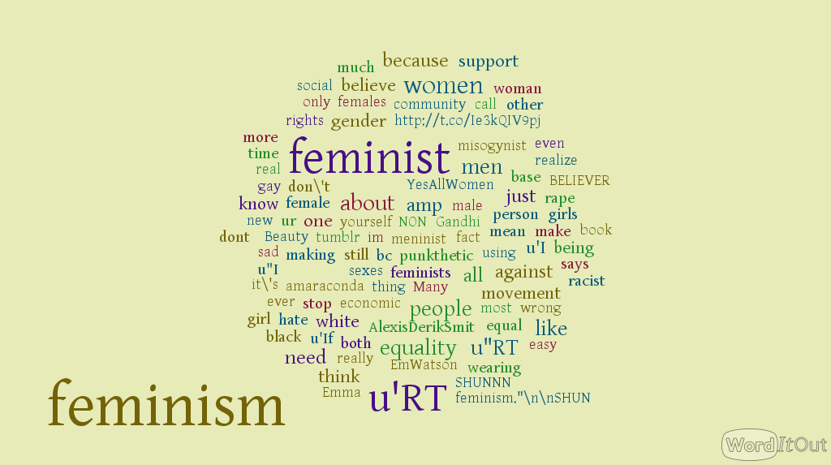
Word Cloud of Positive Tweets

Slide 18
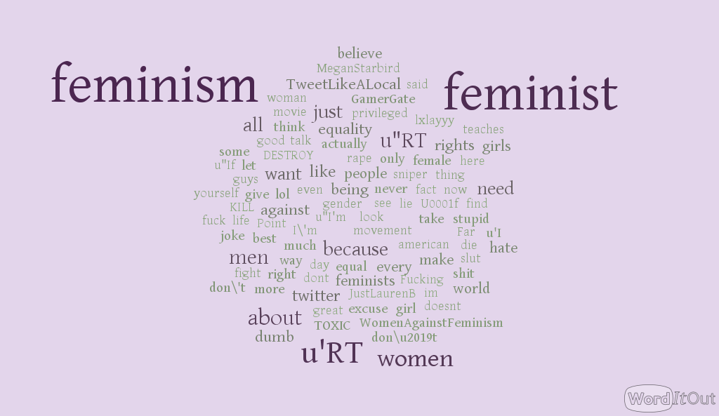
Word Cloud of Negative Tweets

Slide 19
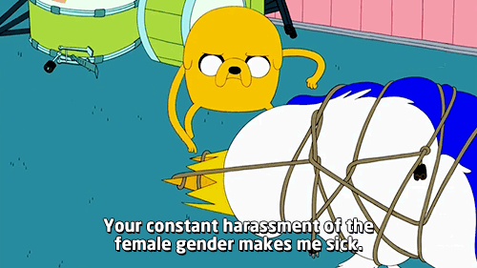
Results: Twitter Doesn’t Love Feminism
Twitter is, according to my models, 54% negative on feminism

Slide 20
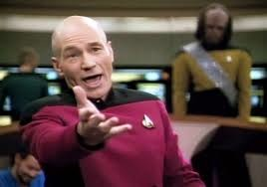
Most retweeted tweets:
The Most Popular
‘RT @MeninistTweet: Today, a feminist asked me how I view lesbian relationships... Apparently "in HD" was not the right answer’

Slide 21
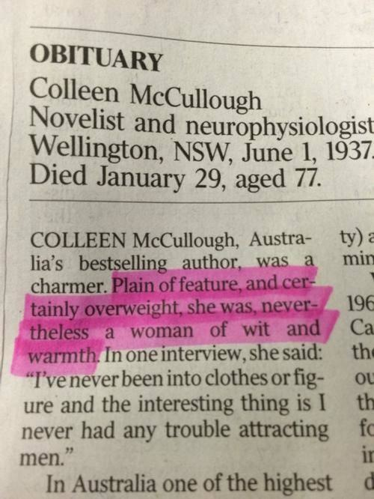
Most retweeted tweets:
RT @vanbadham: Why feminism? Because you can sell 30 MILLION copies of a single book and when you die, The Australian prints this:
RT @vanbadham: Why feminism? Because she was ALSO a FREAKIN' NEUROPHYSICIST at YALE & this is how The Australian begins her obituary

Slide 22
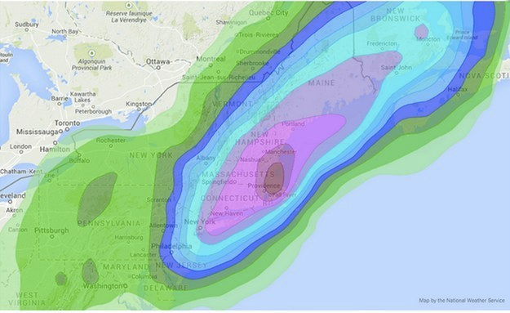
‘RT @JessicaKRoy: finally a feminist snowstorm ‘

Slide 23
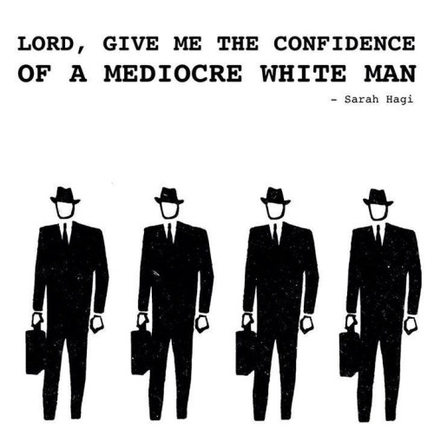
Most retweeted tweets
RT @hayleyestxlle: Feminism has never made me hate men but men's reaction to feminism definitely has.
RT @TheBlackVoice: It's amazing how threatened men are by the term feminist while not even being able to provide a working definition
T @clementine_ford: I keep hearing that feminism is bad for women, and I think what that's supposed mean is that feminism is bad for men

Slide 24
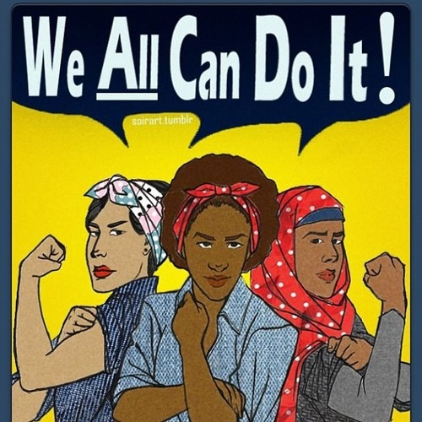
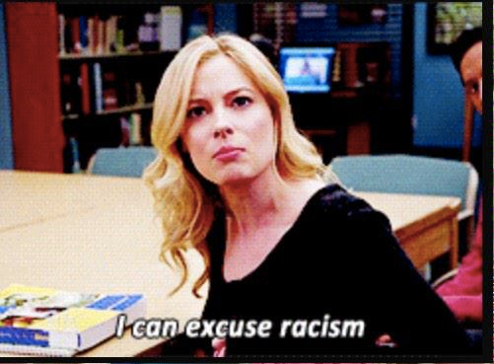
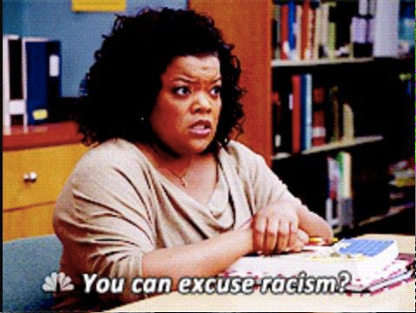
Clusters of Words and Ideas Based On Whole Tweets
Intersectionality

Slide 25
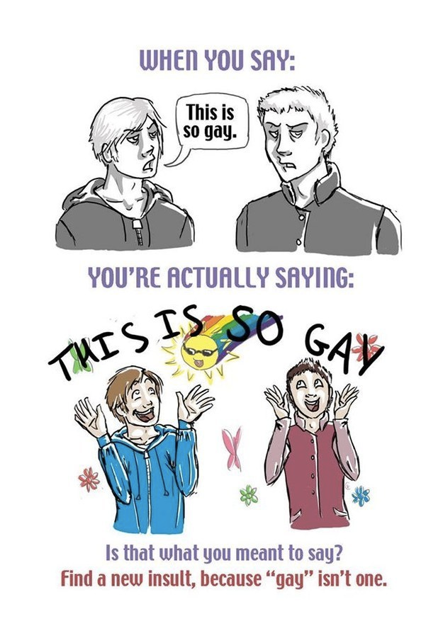
Vocabulary Problem
“RT @TheBlackVoice: It’s amazing how threatened men are by the term feminist while not even being able to provide a working definition of it.”
I think the point of #WomenAgainstFeminism is the radical notion that equality & decency is more important than the label it operates under.”
“RT @awmarissa: Girls who shit on feminism need a reality check you’re literally pushing things back. How can you be against equal rights?”
‘RT @snoozyloser: if ur a girl that is against feminism why r u voting. why r u wearing pants. how can u read’,
‘RT @OGTREEZ: Everytime you say feminist you gotta say men too.’

Slide 26

General Hate Speech
'do not rape a feminist it would fulfill her hot rape fantasies and let us be honest what kind of animal would want to make a feminist happy’

Slide 27
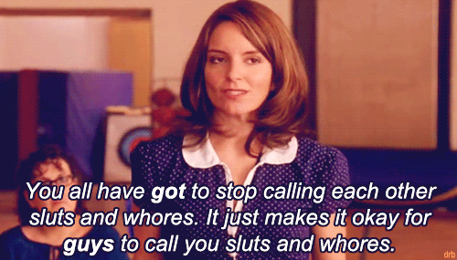
Women Against Feminism
“RT @CeeJayCraig: Yes, I am woman. No, I'm not a radical feminist.Why? Men don't have a single right that I don't have. It's 2015.”
“ellekersten because theres a difference between a women who is a feminist and a women who wants equal rights feminist are crazy”
'RT @k_mcq: Be a lady, never a feminist.'

Slide 28
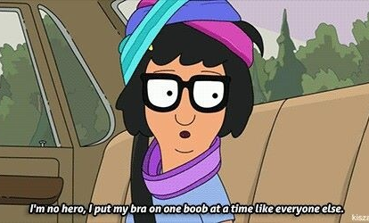
Feminism And New Media

Slide 29
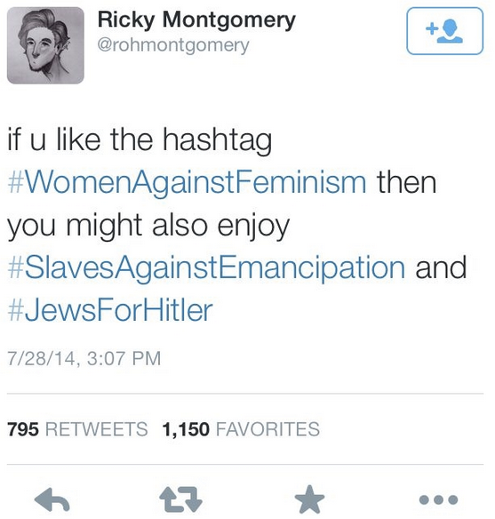
Feminism And New Media
‘i have never said i was feminist bc i dont want all of you dragging me saying im only feminist on twitter or tumblr’
'people who say we dont need feminism and everyone is already equal clearly arent aware of whats going on around the world’
'disturbedfan132 i believe myself to be a feminist and tho i disagree with the new femfad they sometimes make points’

Slide 30
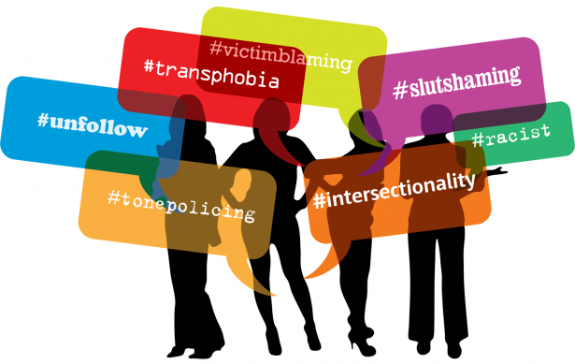
Smaller Clusters/LDA
Humor as Defense? u, jokes, r, it's, don't, joke!, seriously!, toxic!!, haha!
Intersectionality? never, one, make, women, misconceptions, base, movement, black, people, feminist/misandriuc,, non-feminists, poster, posters
@NoToFeminism women, teaches, stupid, lol, entice, enthrall, enchant,and, berate, nag,, tradition, demand, how's, freeing,
YesAllWomen: it's, women, equal, incomprehensibly, and, still, acknowledge, #ineedfeminismbecause, @prowomanchoice, men, #yesallwomen, 2015, want, tube
Witchcraft?kill, woman, husbands, witchcraft,, encorauges, lesbianism, children, capitalism, practice, destroy, leave, become, movement, need
Media Response: forced, chapter, perspectives, normal, man's, cuoco, kaley, apologize, respects, interesting, cissexist, ('females'), extending, simplistic
Trendy Feminism: equality, support, gender, believe, women, want, tumblr,, aspe…, "trendy"
Intersectionality: white, room, appropriation, responds,feminist™, cultures, obligation, claiming, racist
Media Representation: people, annoying, "hollywood's, year", languages, #girlsmatter, silent?, acculturated
Anti-Feminist Pro-Equality Paradox:≠, calling, making, women, i, theory, #equalist, @victorialwalton, #stoptheimmaturity, #misandrist, #letsbereal

Slide 31
Discussion
Grade level of negative tweets consistently measured as at least a grade level below neutral/pro-feminist tweets
Higher levels of profanity and misspelling in negative tweets

Slide 32
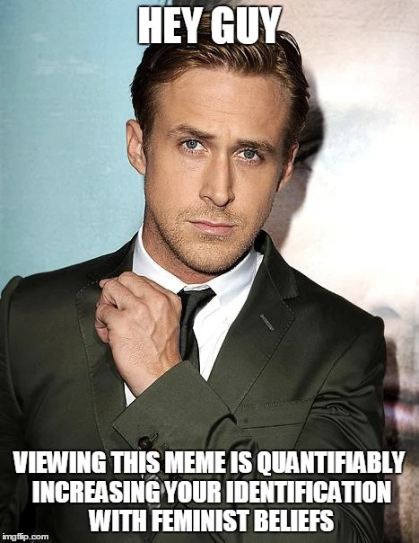
Improvements Required to Progress Beyond Pilot
Constrained by small codified samples and the need to have both test and train sub-sets, accuracy could be improved by increasing number of codified tweets, ideally codified by multiple people to control for individual bias.
Sample size is 217 negative and 217 positive tweets to 30k uncoded tweets
Goal: Have the script running constantly to display a stock market value of feminism on Twitter and how real time events affect it.
Be able to monitor twitter-verse for how events impact the public’s view on feminism, what causes backlashes, measure impact of Beyonce, etc

